Slide 1
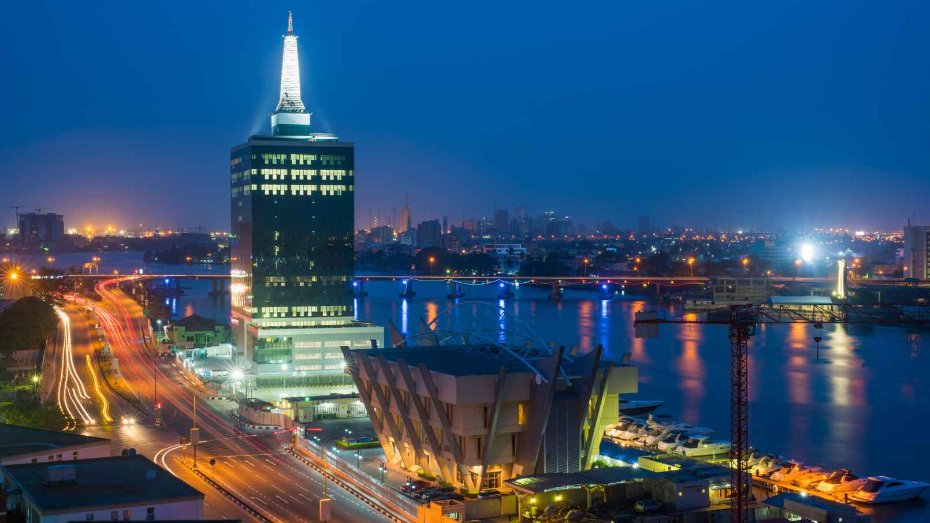

Flux Limited is a social enterprise with the primary objective of enabling the No. 9 goal of the SDG’s; Innovation, Industry and Infrastructure. We support businesses capture opportunity through energy solutions with focus on the aquaculture, housing and manufacturing sectors across Sub- Saharan Africa.
We Decarbonize, Decentralize and Digitalize energy supply and consumption to ensure operational efficiency and business profitability.

Slide 2



Aquaculture
Housing
Manufacturing
Enable women-led SME’s succeed in the fish retail business by leasing solar powered refrigerator to help preserve their stock and maximize their profit.
Support the operational efficiency of elevators in buildings; commercial real estate and social housing schemes. This will enable operational efficiency and open new streams of profitability.
We take the operational and production burden off SME’s operating in emerging markets so they can get to market faster and ready to go.

Slide 3
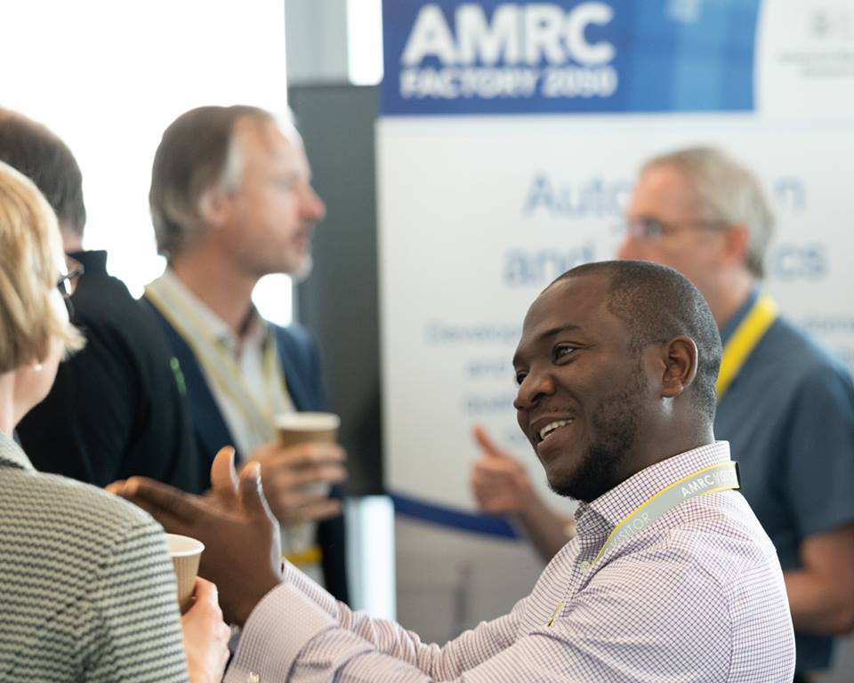
Founder
Yusuf Bilesanmi is a Power and Infrastructure Professional with business & project development experience from Japan, Europe and Anglophone Africa.
Having worked with multinationals such as Panasonic Corporation and Mitsubishi Corporation, Yusuf combines his skills of managing large projects and trading electronic items to identify and develop missed opportunities across the value chain.
Bsc. and Msc. in Information Technology with research focused on Smart Grid from Ritsumeikan (APU) Japan and Waseda University Japan respectively. Post Grad in Sustainability from Cambridge University UK.
He is ethical in his business practice, adheres to business compliance measures and upholds sustainability in his business processes ensuring that value is created for the environment, society (Clients etc.) and partners (shareholders etc.).

Slide 4
Contact Us
admin@fluxconltd.com
447492535908
2348060327746

